Slide 2

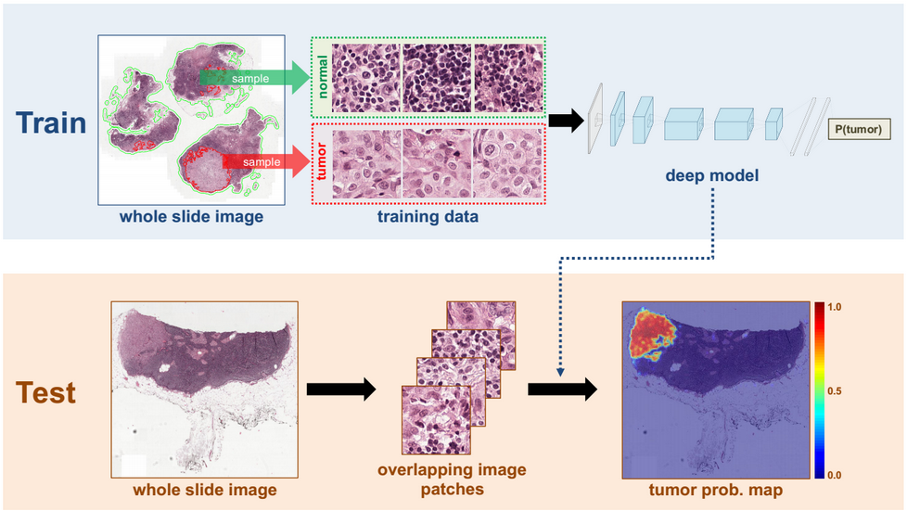
ENGINEERING MACHINE LEARNING
HEALTH TECHNOLOGY
https://towardsdatascience.com/understanding-cancer-using-machine-learning-84087258ee18

Slide 3
MACHINE LEARNING for Health tech
GROUPS

Slide 4
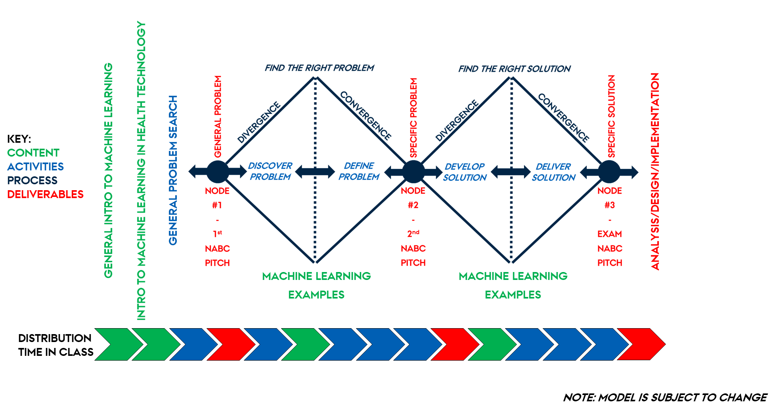
MACHINE LEARNING for Health tech
DOUBLE
DIAMOND

Slide 5
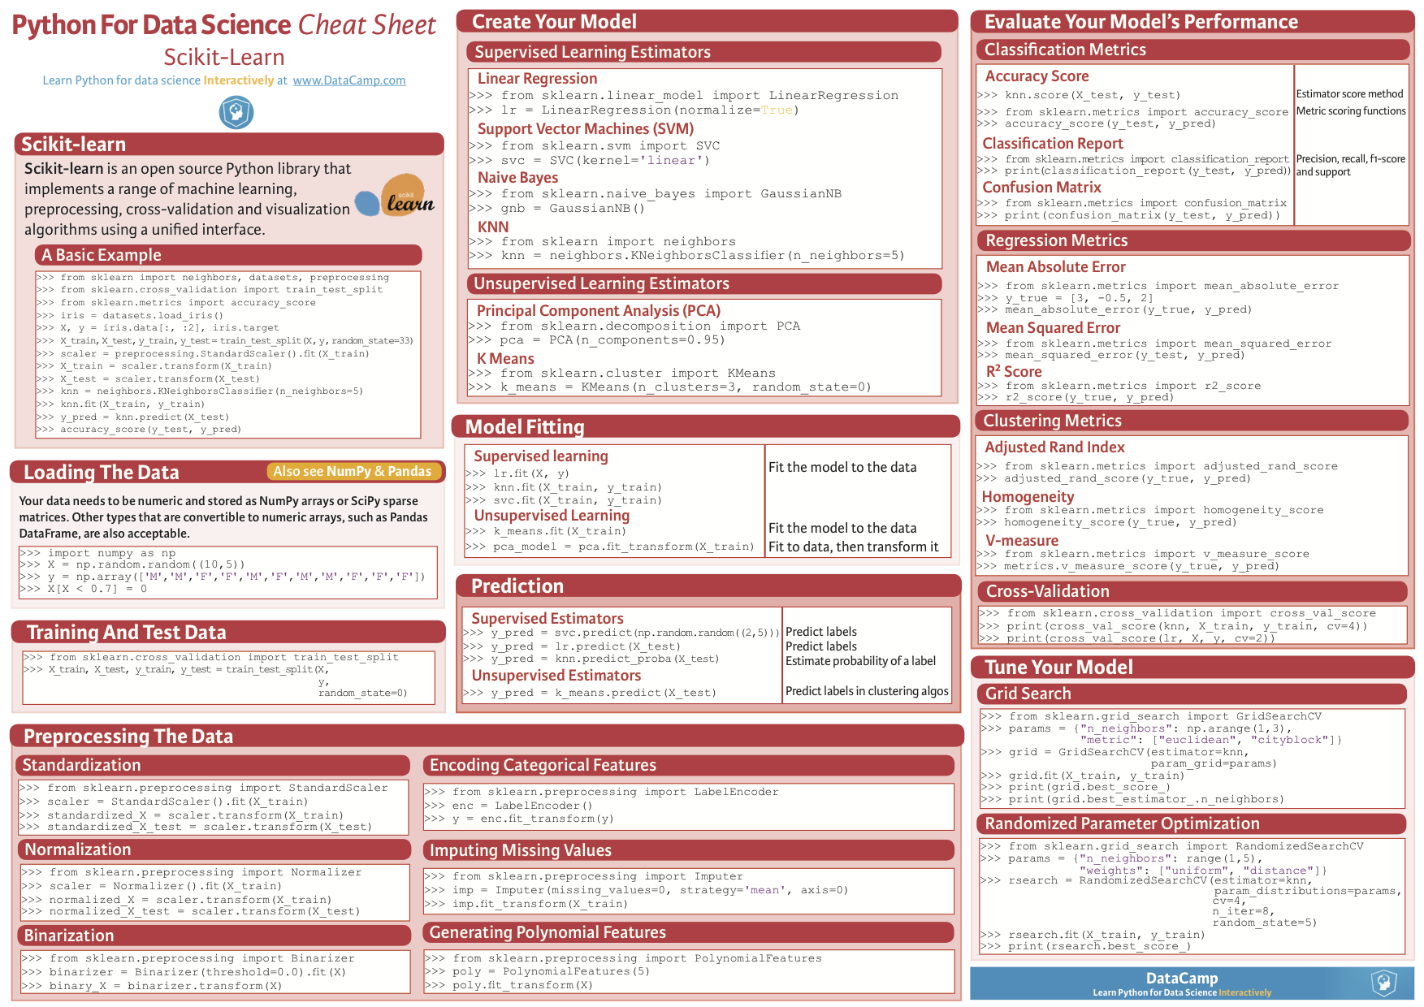
MACHINE LEARNING for Health tech
model.fit() model.predict() model.fit_transform()
model.transform()

Slide 6
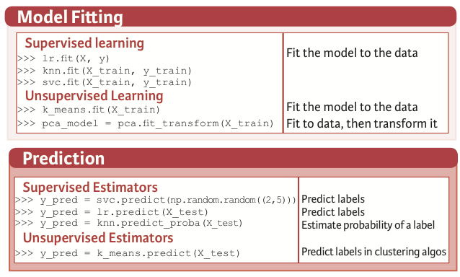
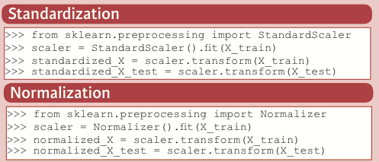
MACHINE LEARNING for Health tech
model.fit() model.predict() model.fit_transform()
model.transform()

Slide 7
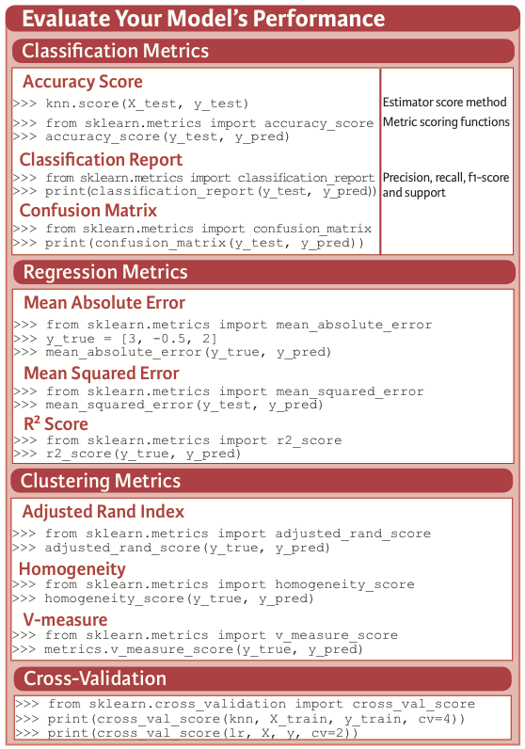
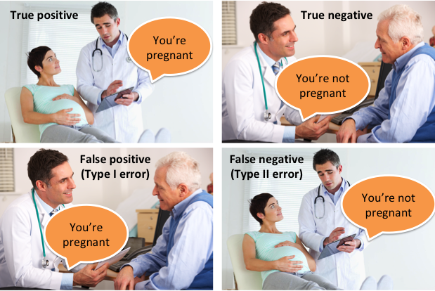
MACHINE LEARNING for Health tech
METRICS (SCORES)

Slide 8
MACHINE LEARNING for Health tech
METRICS (SCORES)

Slide 9
MACHINE LEARNING for Health tech
METRICS (SCORES)

Slide 10
MACHINE LEARNING for Health tech
METRICS (SCORES)
sensitivity
1-specificity

Slide 11
MACHINE LEARNING for Health tech
METRICS (SCORES)

Slide 12
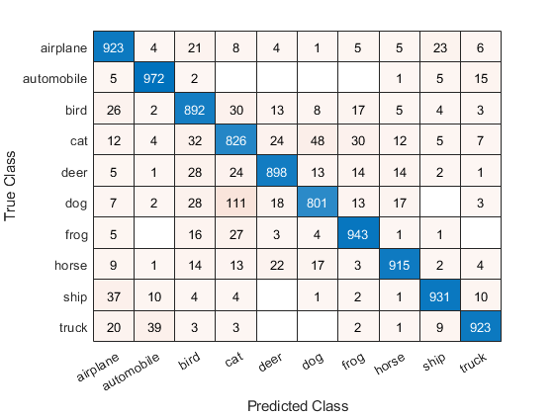
MACHINE LEARNING for Health tech
METRICS (SCORES)

Slide 13
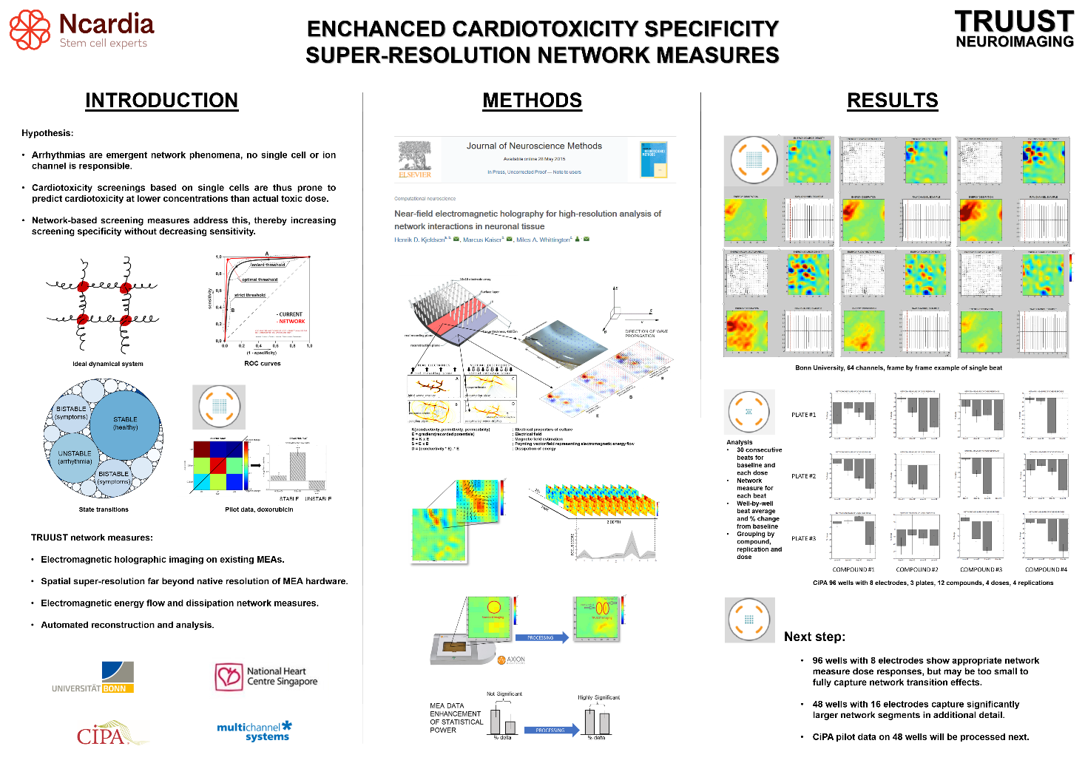
MACHINE LEARNING for Health tech
ROC CASE STUDY

Slide 14
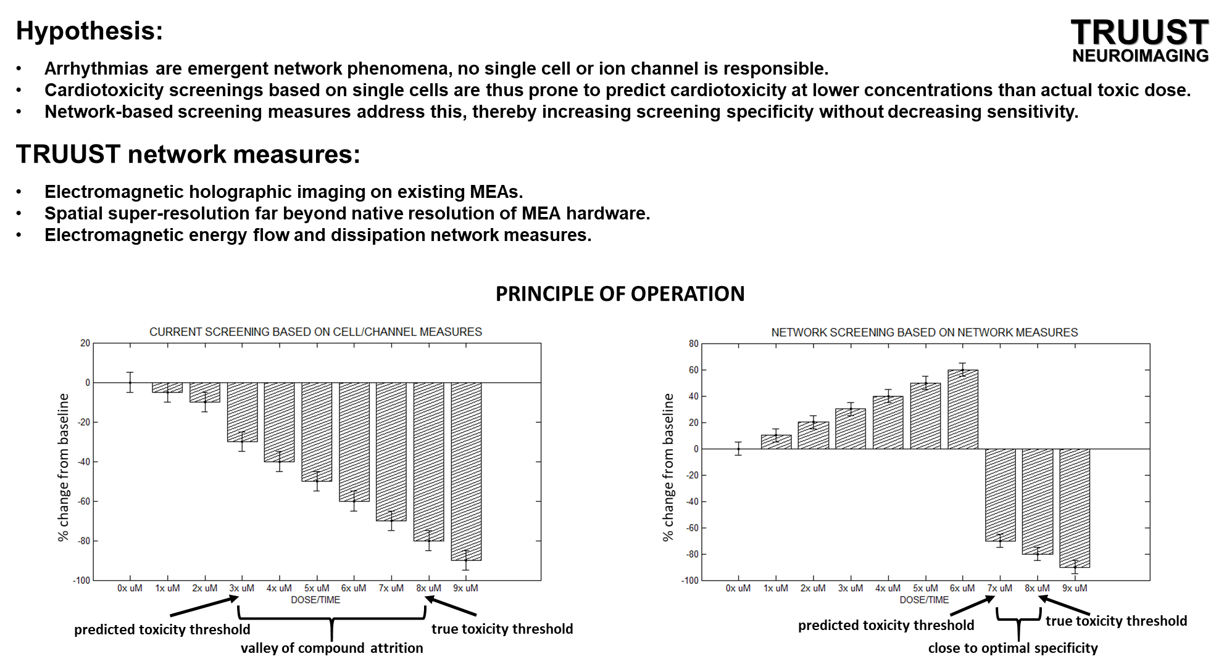
MACHINE LEARNING for Health tech
ROC CASE STUDY

Slide 15
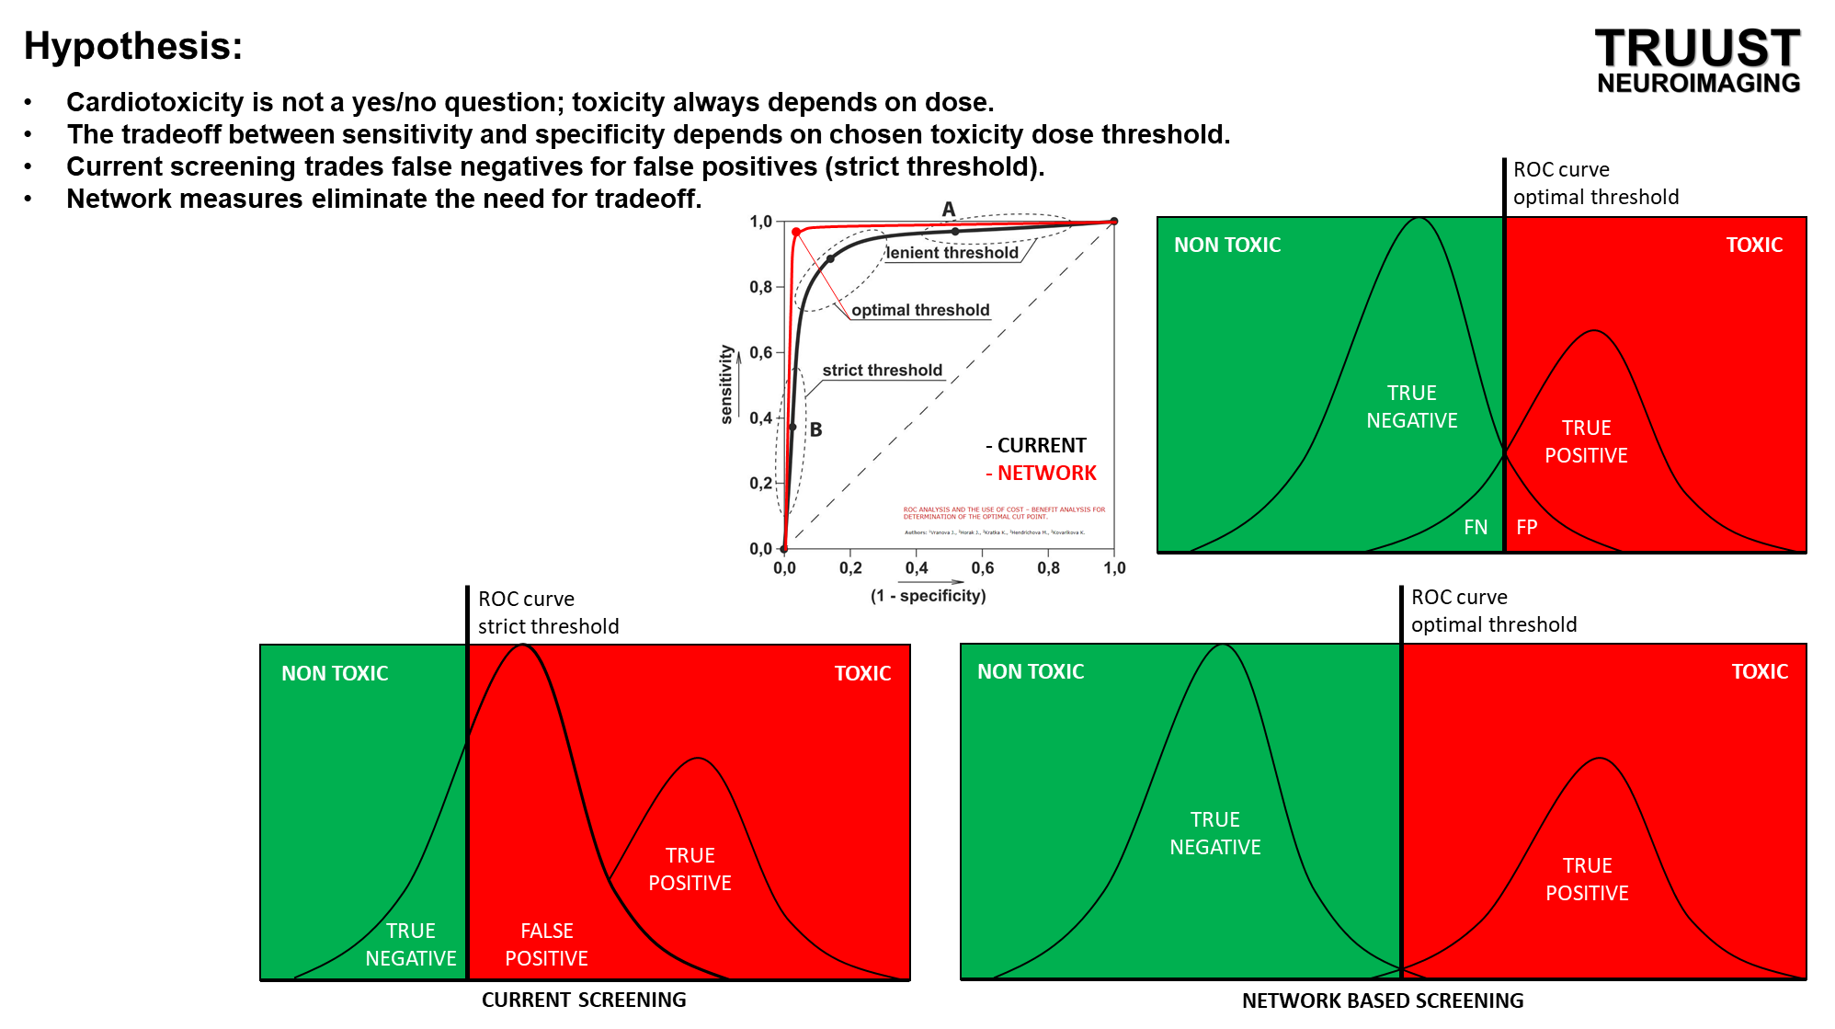
MACHINE LEARNING for Health tech
ROC CASE STUDY

Slide 16
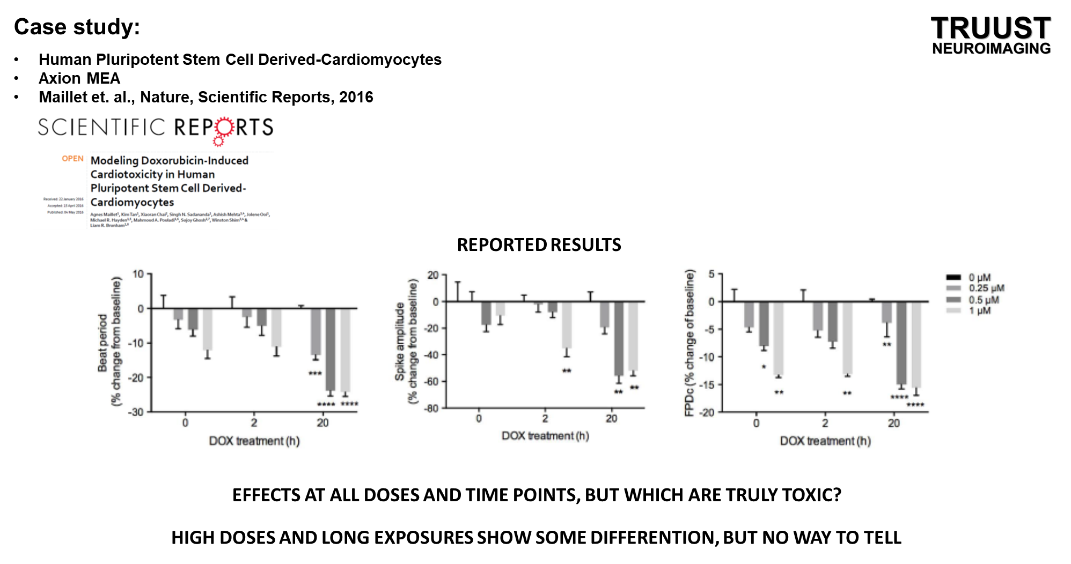
MACHINE LEARNING for Health tech
ROC CASE STUDY

Slide 17
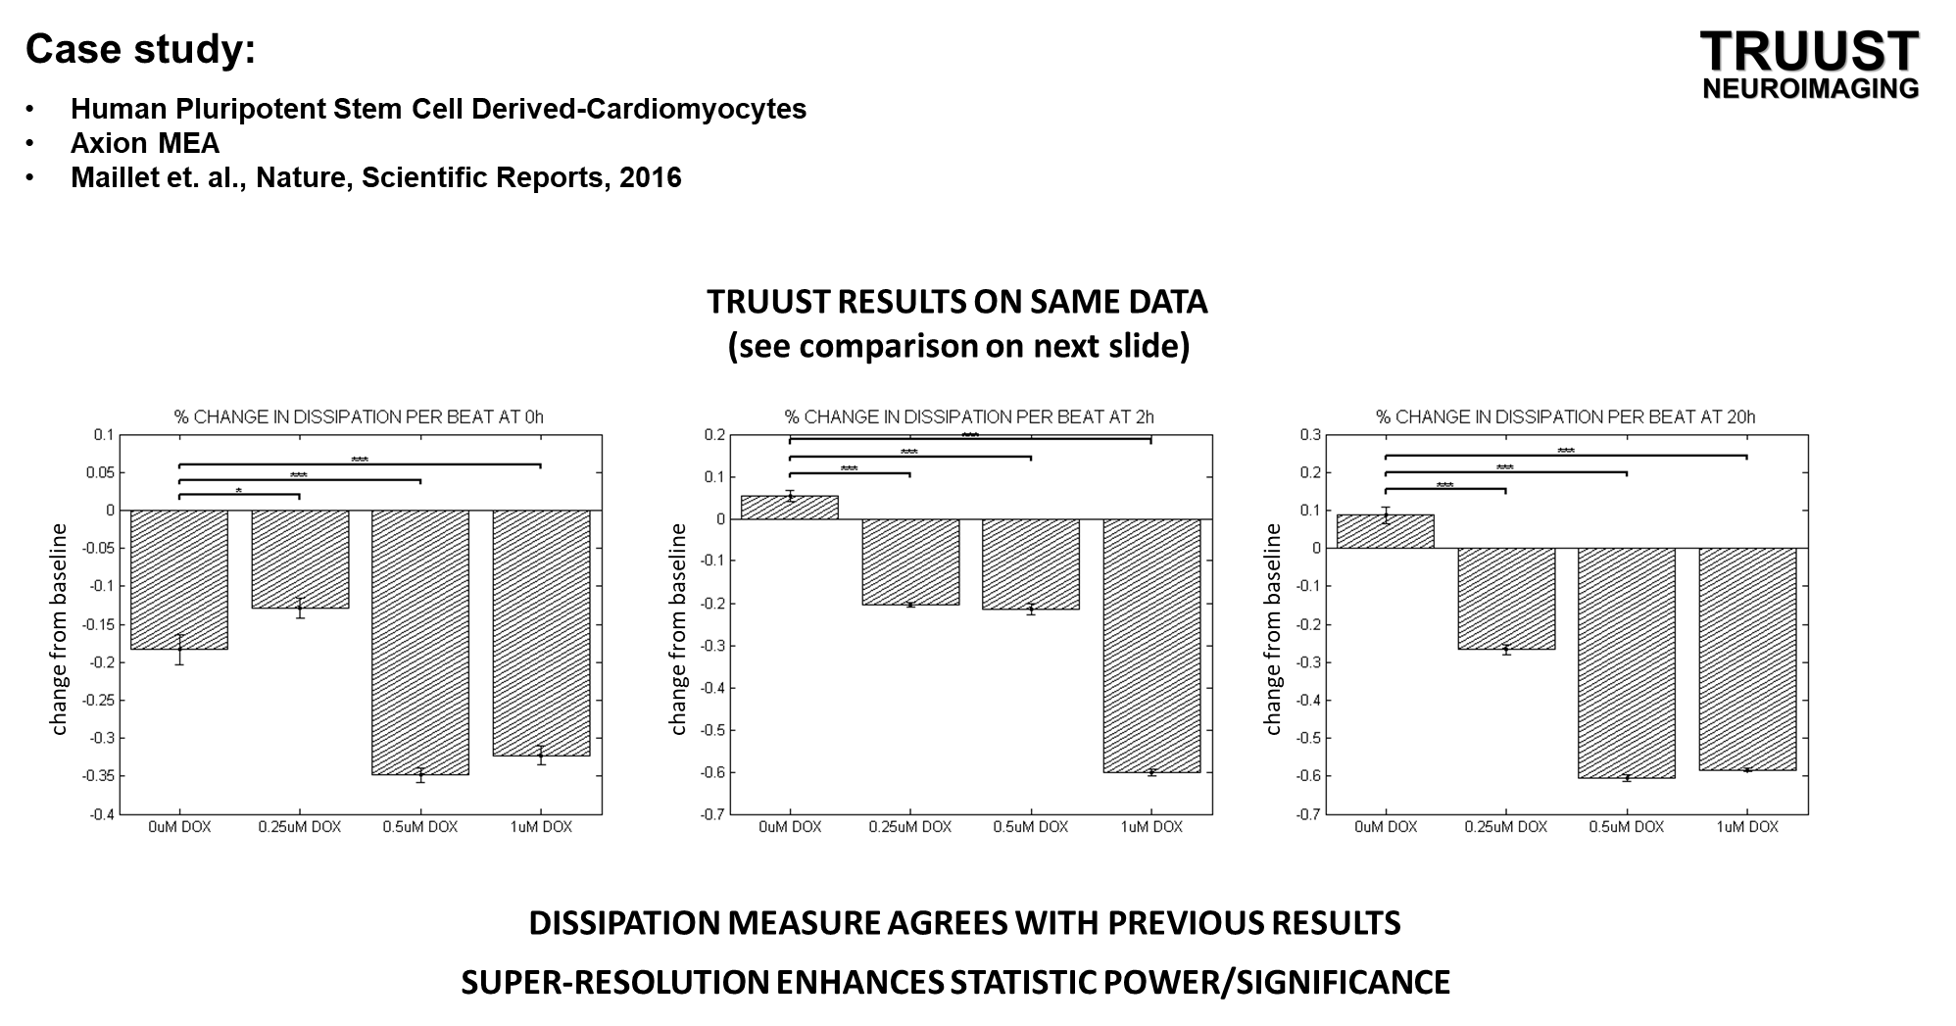
MACHINE LEARNING for Health tech
ROC CASE STUDY

Slide 18
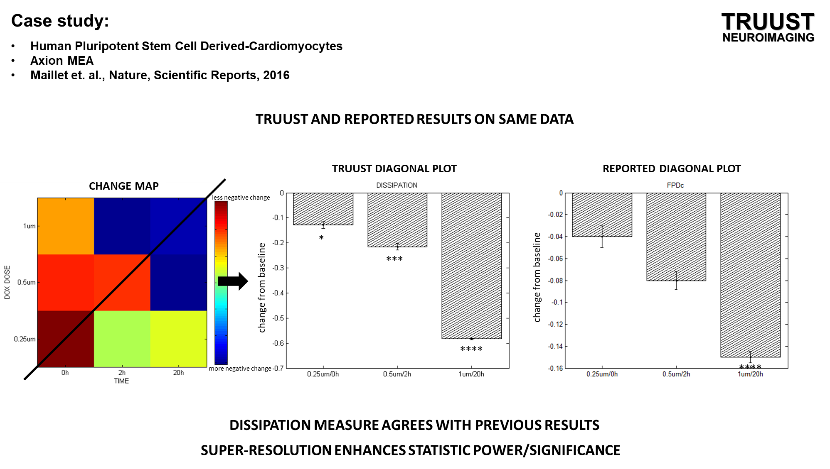
MACHINE LEARNING for Health tech
ROC CASE STUDY

Slide 19
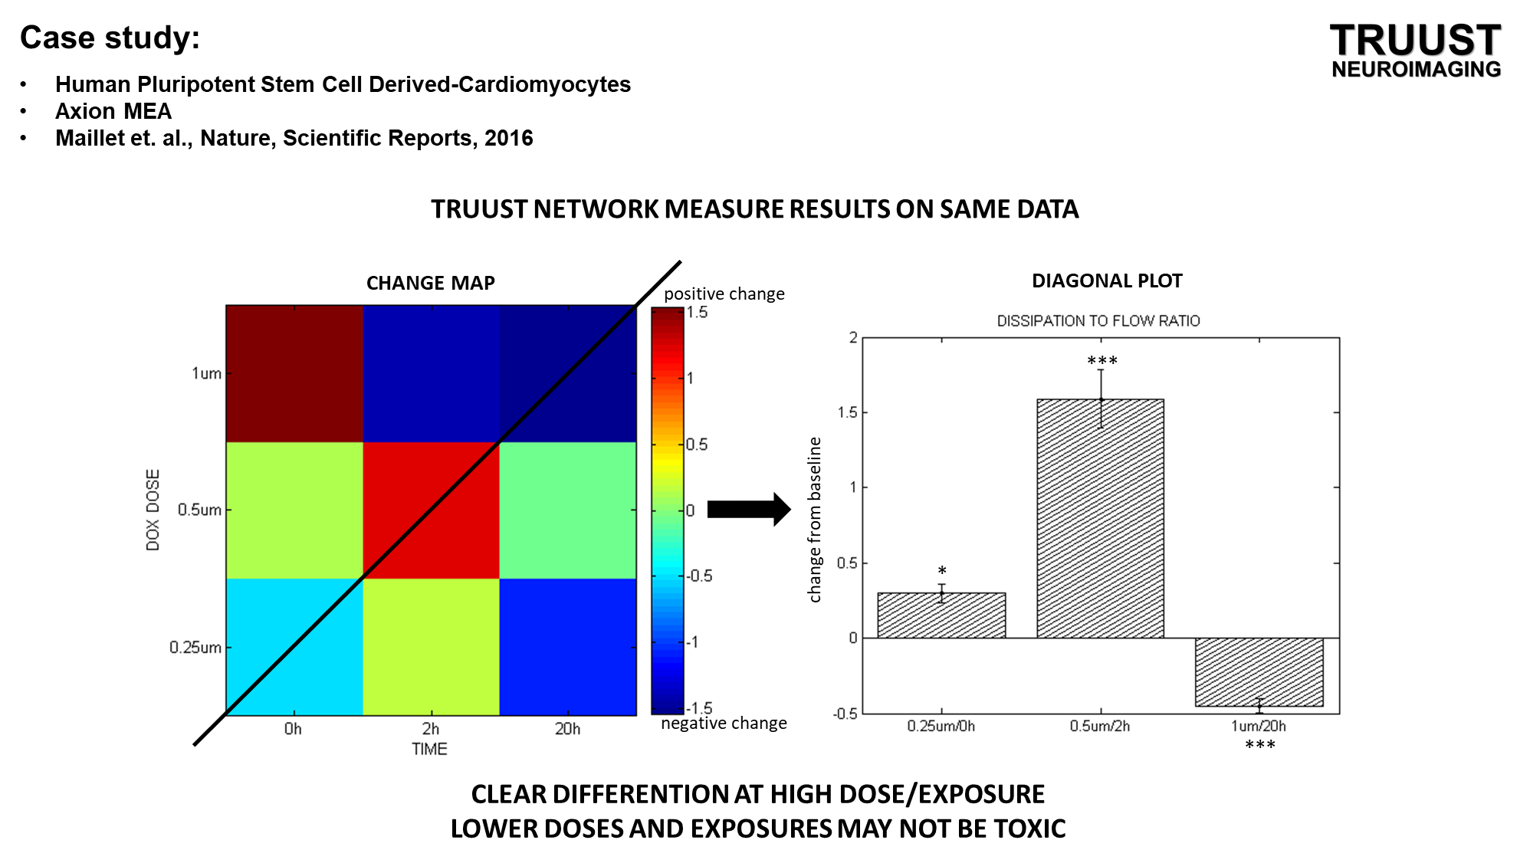
MACHINE LEARNING for Health tech
ROC CASE STUDY

Slide 20
MACHINE LEARNING for Health tech
GRADIENT DESCENT OPTIMIZATION

Slide 21
MACHINE LEARNING for Health tech
GRADIENT DESCENT OPTIMIZATION

Slide 22
MACHINE LEARNING for Health tech
GRADIENT DESCENT OPTIMIZATION

Slide 23
MACHINE LEARNING for Health tech
GRADIENT DESCENT OPTIMIZATION

Slide 24
MACHINE LEARNING for Health tech
POLYNOMIAL REGRESSION

Slide 25
MACHINE LEARNING for Health tech
POLYNOMIAL REGRESSION

Slide 26
MACHINE LEARNING for Health tech
POLYNOMIAL REGRESSION

Slide 27
MACHINE LEARNING for Health tech
REGULARIZATION AGAINST OVERFITTING

Slide 28
MACHINE LEARNING for Health tech
DECISION BOUNDARIES

Slide 29
MACHINE LEARNING for Health tech
DECISION BOUNDARIES

